Slide 1
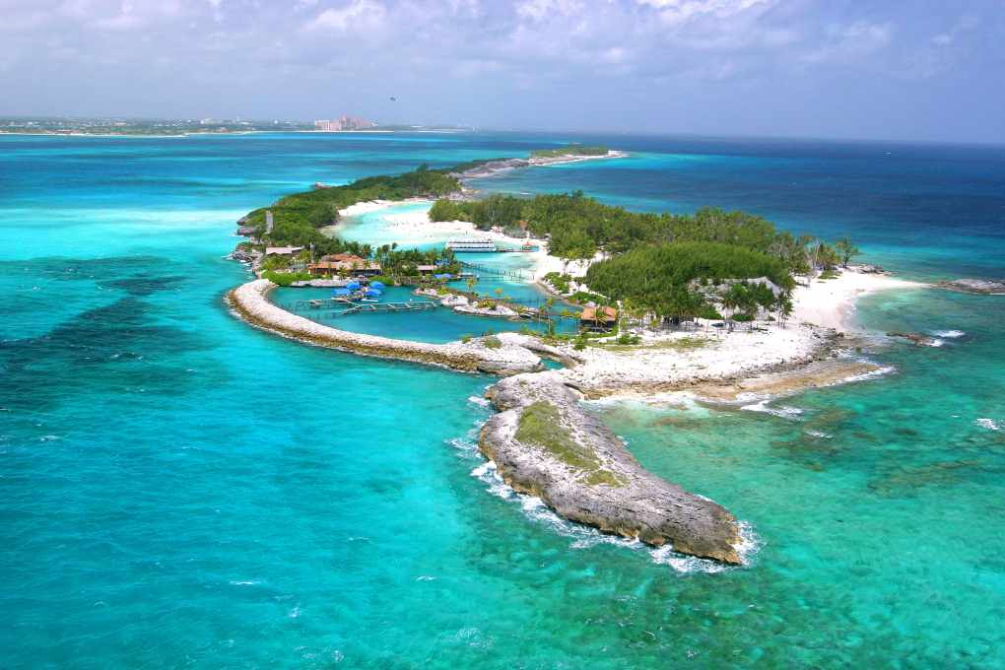
Bahamas nassu
By: Sharrah Prad

Slide 2
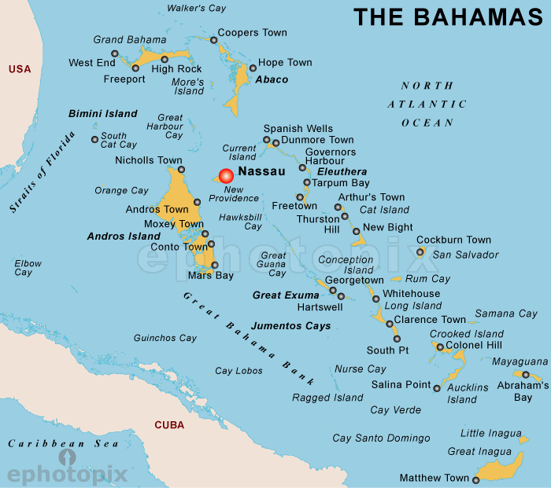
Location
Bahamas is location in South America

Slide 3
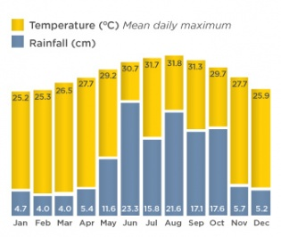
Physical Features
There are no rivers in The Bahamas. The Bahamas has the world’s third-longest barrier reef. Five percent of the world’s coral can be found in the waters of the Bahamas. The Lucayon National Park on Grand Bahama Island is the site of the world’s longest known underwater cave and carven system.

Slide 4
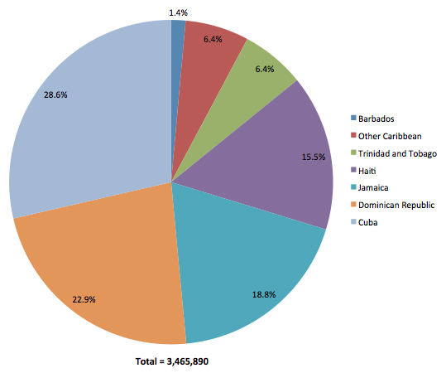
Climate
Weather and Climate information for Nassu Bahamas. Average monthly, Rainfall, (millimeters, sunshine, min and max. The Climate is mild, with an average winter temperature of about 70f (21c).

Slide 5
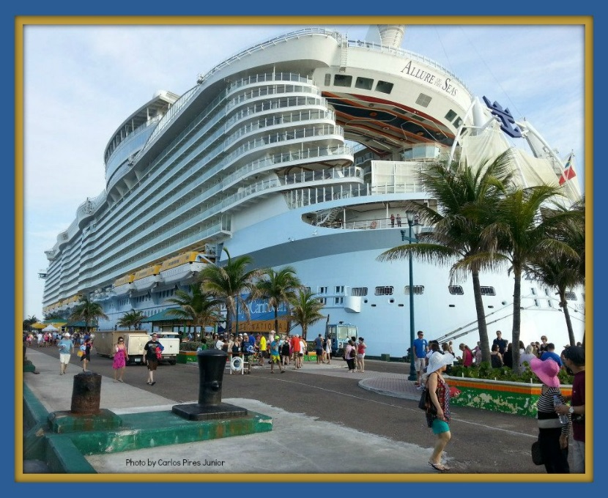
Capital
Nassu is the Capital of the Bahamas, is a bustling metropolitan hub full of culture and modern amentities. To the North lies Paradise Island.

Slide 6
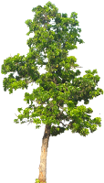
Native plants
Plants, Horticulture, Trees and bush medicine in long Island, Bahamas… an easier time with the salt water. The tallest palm in the circle is a Native Palm Tree.

Slide 7
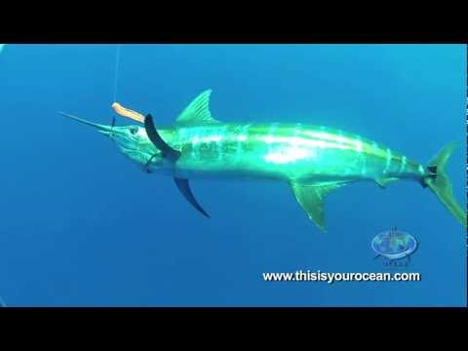
Native animals
The Bahamas has many amazing animal, that are on land in the water. It also has many tropical plants such as flower and many trees. You can see many marine animals around the Bahamas sum as clown fish, angel fish, the Nassu grouper which is only found in the Bahamas.

Slide 8
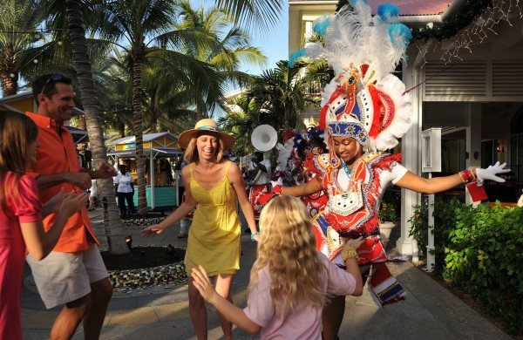
Culture and customs
The Bahamas has a distance culture which has evolved over generations, from a mixture of mostly African combined with some British Colonial and American influence. To a unique colorful style of Bahamas self-expression. Bahamian are best described as an easy-going, friendly and hospitable people.

Slide 9
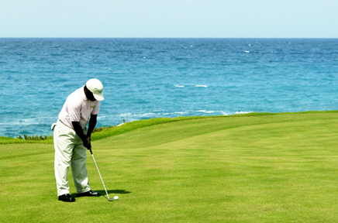
Sports
People that stay in the Bahamas the sport they play are golf, tennis, and truck but they actually play golf a lot .

Slide 10
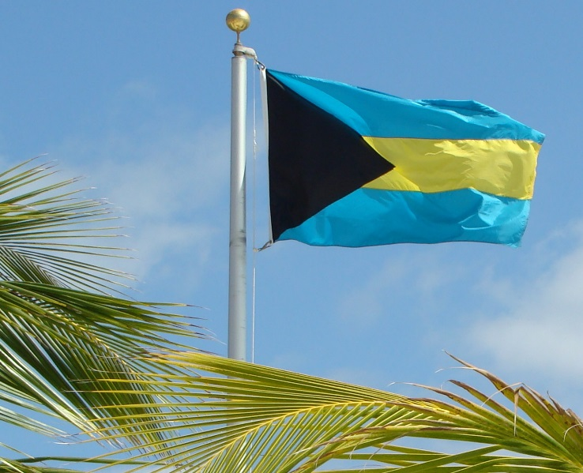
Native dress/clothing
The Bahamas attract affluent and successful people, who either make their homes on the islands or vist to enjoy a respite from the often strict confines imposed upon them elsewhere by their rank or positions. While locals wear flip-flops, cut-off jeans shorts and T-shirts with all manner of logs, vistors at the Swankier Hotels or to dine in casual restaurants.

Slide 11
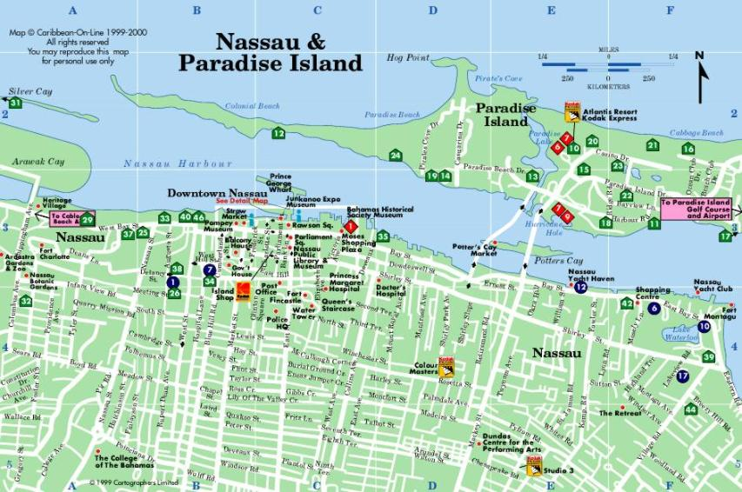
Food
Many Bahamian dishes include simple vegetables such as peas, which people cook in a number of ways. Common preparation methods include mixing with salt pork and spices or tossing with hot sauce. Many people combine peas and rice to make the island dish called "peas n' rice." Fruits such as papayas, guavas, mangoes, pineapples and passion fruit are common in the Bahamas. Residents and tourists alike enjoy fruits added to ice cream and made into puddings.

Slide 12
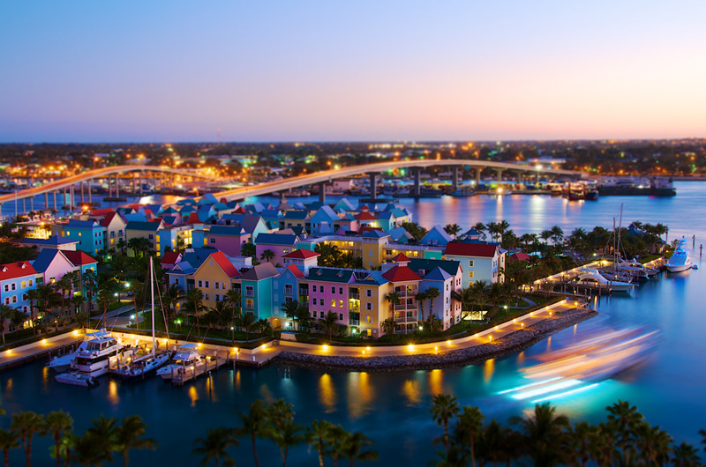
Religion
The Religion of the Bahamas paliamentry Democracy

Slide 13
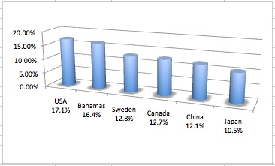
Education
Education in the Bahamas is compulsory between the ages of 5 and 1. As 2003,the school attendance rate was 92% and the literacy rate was 95.5% The government fully operates 158 of the 210 primary and secondary schools in the Bahamas.

Slide 14
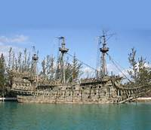
History
The population of Nassu grew so did it’s populated areas. Today the city dominates the entire island and its satellite, Paradise Island, However, until the post-second world war era, the outter suburb, scarcely existed, Most of New providence was uncultivated bush until loyalists were resettled there following the American Revolutionary War, They established several plantations, such as Clifton and Tusculum. Slaves were ported.

Slide 15
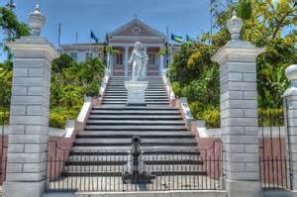
Government
The government of Bahamas is parliamentary Democracy.

Slide 16
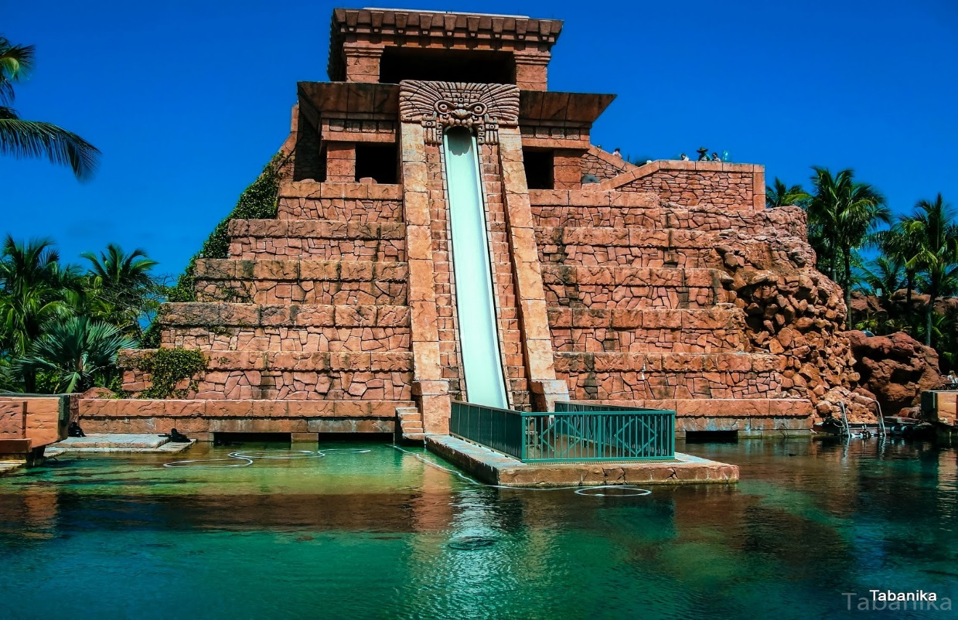
Language
The language people speak in Bahamas are English and Creole

Slide 17
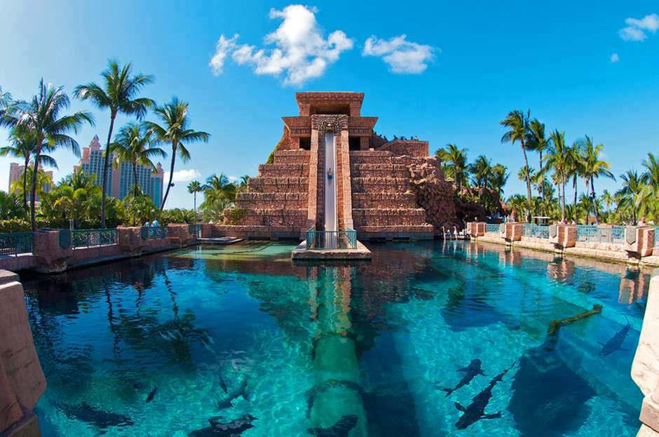
Population
The population of the Bahamas are 301,000 and 58 per sq. mi, 22 per sq. km

Slide 18
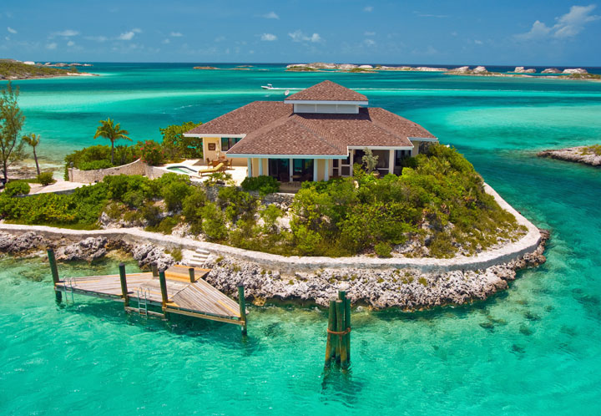
The End

